Slide 1
Chapter 7
Run-Time Environments

Slide 2
Activation Tree
We can use a tree (called activation tree) to show the way control enters and leaves activations.

Slide 3
过程的活动树
program main; enter main
procedure s; enter p
begin ... end; enter q
procedure p; exit q
procedure q; enter s
begin ... end; exit s
begin q; s; end; exit p
begin p; s; end; enter s
exit s
exit main
A Nested Structure

Slide 4
Activation Tree (cont.)
main
p
s
q
s

Slide 5
Quicksort Code (1)
program sort(input, output);
var a : array [0..10] of integer;
procedure readarray;
var i : integer;
begin
for i := 1 to 9 do read(a[i])
end;
function partition(y,z : integer) : integer
var i, j, x, v : integer;
begin
…
end;
…

Slide 6
Quicksort Code (2)
…
procedure quicksort(m, n : integer);
var i : integer;
begin
if (n > m) then begin
i := partition(m, n);
quicksort(m, i-1);
quicksort(i+1, n)
end
end;
begin
a[0] = -9999; a[10] = 9999;
readarray;
quicksort(1, 9)
end.

Slide 7
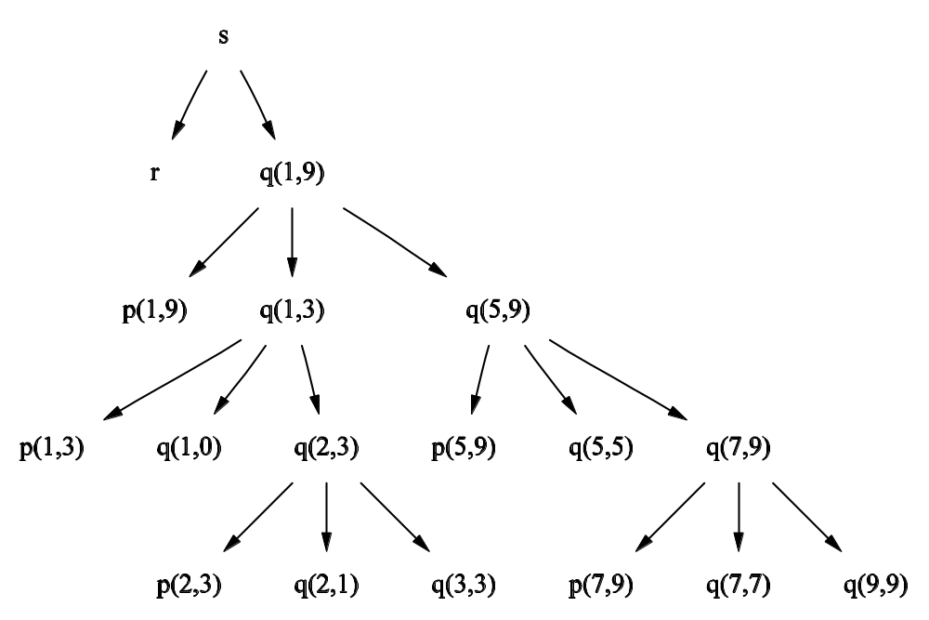

Slide 8
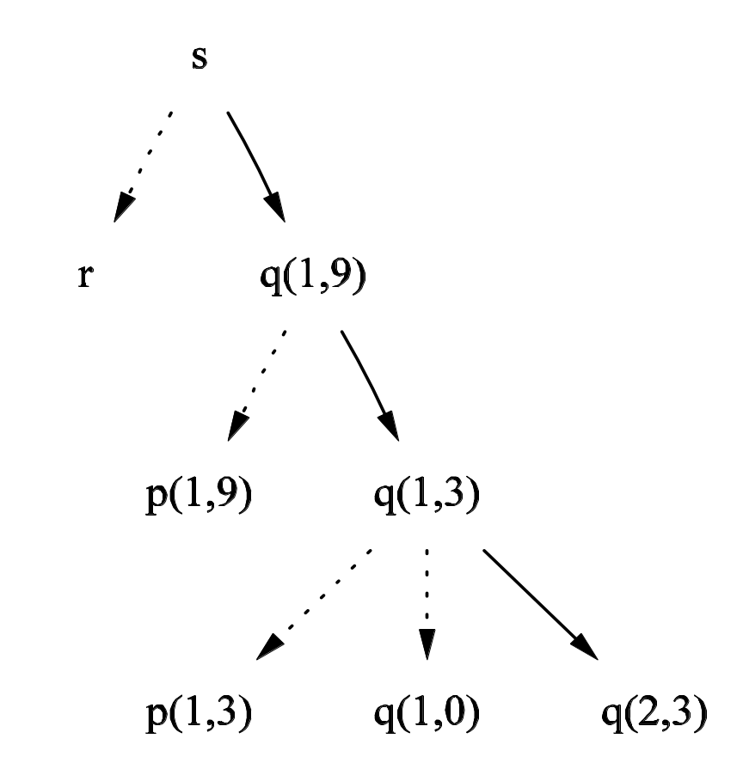
栈中的活动

Slide 9
procedure p;
var b:real;
procedure q;
var a: integer; a is local
begin a := 1; b := 2; end;b is non-local
begin ... end;

Slide 10
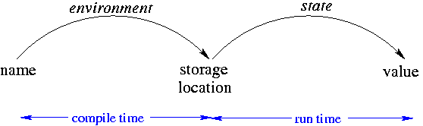
Bindings of Names

Slide 11
运行时栈中的组织
Memory locations for code are
determined at compile time.
Locations of static data can also be
determined at compile time.
Data objects allocated at run-time.
(Activation Records)
Other dynamically allocated data
objects at run-time. (For example,
malloc area in C).
Code
Static Data
Stack
Heap

Slide 12
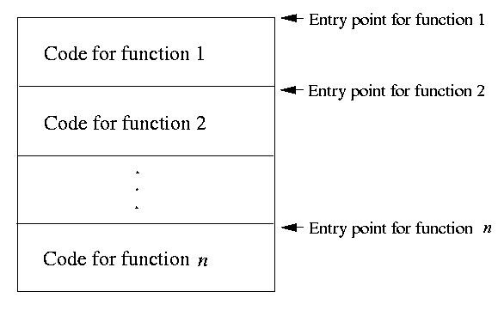

目标代码的管理
Usually, code is generated a function at a time.

Slide 13
活动记录
The returned value of the called procedure is returned
in this field to the calling procedure. In practice, we may
use a machine register for the return value.
The field for actual parameters is used by the calling
procedure to supply parameters to the called procedure.
The optional control link points to the activation record
of the caller.
The optional access link is used to refer to nonlocal data
held in other activation records.
The field for saved machine status holds information about
the state of the machine before the procedure is called.
The field of local data holds data that local to an execution
of a procedure..
Temporay variables is stored in the field of temporaries.
return value
actual parameters
optional control link
optional access link
saved machine status
local data
temporaries

Slide 14
Activation Records (Ex1)
stack
main
p a:
q b:
program main;
procedure p;
var a:real;
procedure q;
var b:integer;
begin ... end;
begin q; end;
procedure s;
var c:integer;
begin ... end;
begin p; s; end;
main
p
s
q

Slide 15
Activation Records for Recursive Procedures
program main;
procedure p;
function q(a:integer):integer;
begin
if (a=1) then q:=1;
else q:=a+q(a-1);
end;
begin q(3); end;
begin p; end;
main
p
q(3) a: 3
q(2) a:2
q(1) a:1

Slide 16
Example_1:Data layouts
在SPARC/Solaris工作站上下面两个结构的size分别是24和16，为什么不一样？
typedef struct _a{ typedef struct _b{
char c1; 0 char c1; 0
long i; 4 char c2; 1
char c2; 8 long i; 4
double f; 16 double f; 8
}a; }b;

Slide 17
Example_2:Data layouts
在X86/Linux机器的结果和SPARC/Solaris工作站不一样，是20和16。
typedef struct _a{ typedef struct _b{
char c1; 0 char c1; 0
long i; 4 char c2; 1
char c2; 8 long i; 4
double f; 12 double f; 8
}a; }b;

Slide 18
7.3 存储分配策略
Static allocation lays out storage for all data objects at compile time
Stack allocation manages run-time storage as a stack
Heap allocation allocates and deallocates storage as needed from a heap
Any of one these strategies can be used to manage activation records

Slide 19
栈式分配
当前活跃着的过程活动可以保存在一个栈中
控制栈的内容：s, q (1, 9), q (1, 3), q (2, 3)
s
r
q(1,9)
p(1,9)
q(1,3)
q(5,9)
p(1,3)
q(1,0)
q(2,3)
p(5,9)
q(5,5)
q(7,9)
p(2,3)
q(2,1)
q(3,3)
p(7,9)
q(7,7)
q(9,9)

Slide 20
Stack Allocation-Example(cont.)
Stack allocation of activation records

Slide 21
Stack Allocation-Example(cont.)
Stack allocation of activation records
s
s
a : array

Slide 22
Stack Allocation-Example(cont.)
Stack allocation of activation records
s
s
a : array
r
r
i: integer

Slide 23
Stack Allocation-Example(cont.)
Stack allocation of activation records
s
s
a : array
r
q(1,9)
q (1, 9)
k: integer

Slide 24
Stack Allocation-Example(cont.)
Stack allocation of activation records
s
s
a : array
r
q(1,9)
q (1, 9)
k: integer
p(1,9)
q(1,3)
q (1, 3)
p(1,3)
q(1,0)
k: integer

Slide 25
Creation of An Activation Record (cont.)
return value
actual parameters
optional control link
optional access link
saved machine status
local data
temporaries
Caller’s Activation Record
Caller’s Responsibility
return value
actual parameters
optional control link
optional access link
saved machine status
local data
temporaries
Callee’s Activation Record
Callee’s Responsibility

Slide 26
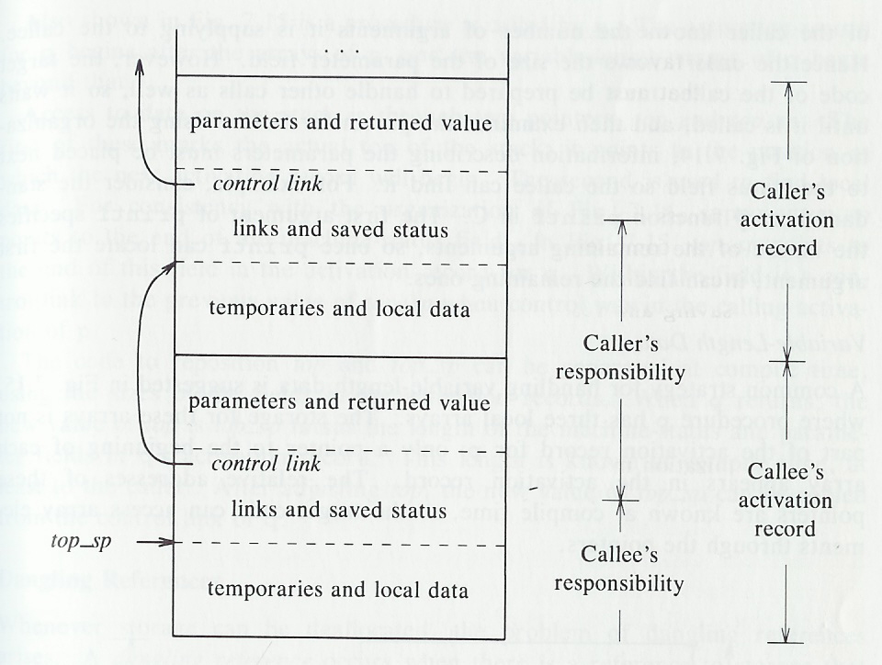
Caller versus Callee

Slide 27
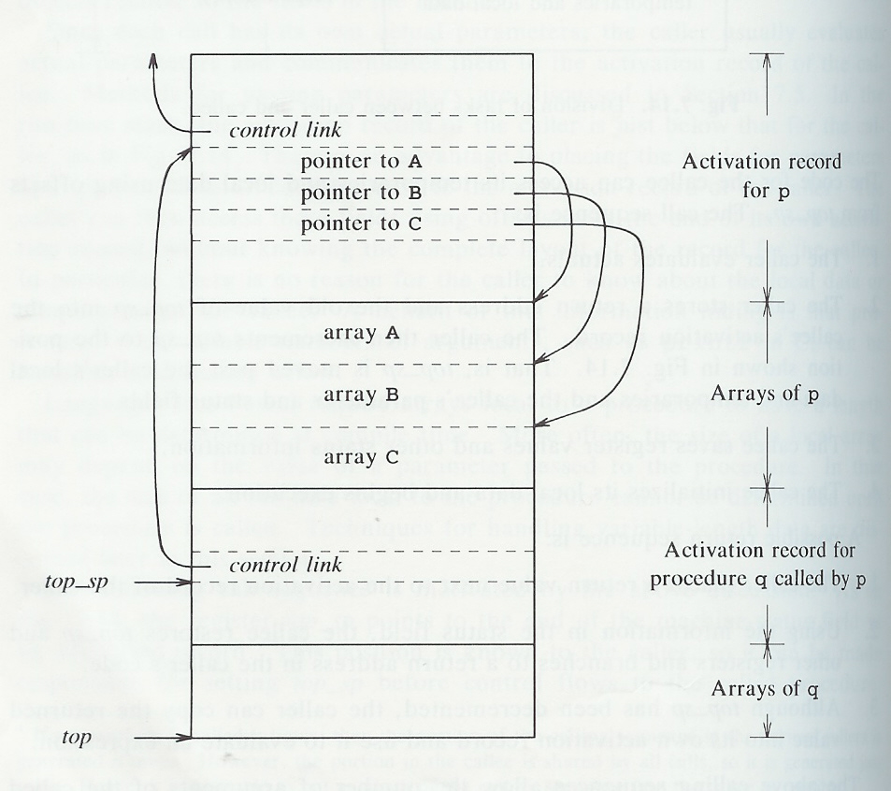
Variable-Length Data Example

Slide 28
Accessing the Stack
Accessing the stack is done through two pointers, top and top_sp
The pointer top:
  Points to the actual top of the stack
  Denotes location where next activation record will be placed
The pointer top_sp:
  Used to locate local data
  Often points to end of machine-status field
The control link of each activation record points to the previous value of top_sp

Slide 29
reposition top and top_sp
Code to reposition top and top_sp when a procedure returns can be generated at compile time.
When q return, the new value of top is top_sp minus the length of the machine-status and parameter field in q’s activation record.
After adjusting top, the new value of top_sp can be copied from the control link of q.

Slide 30
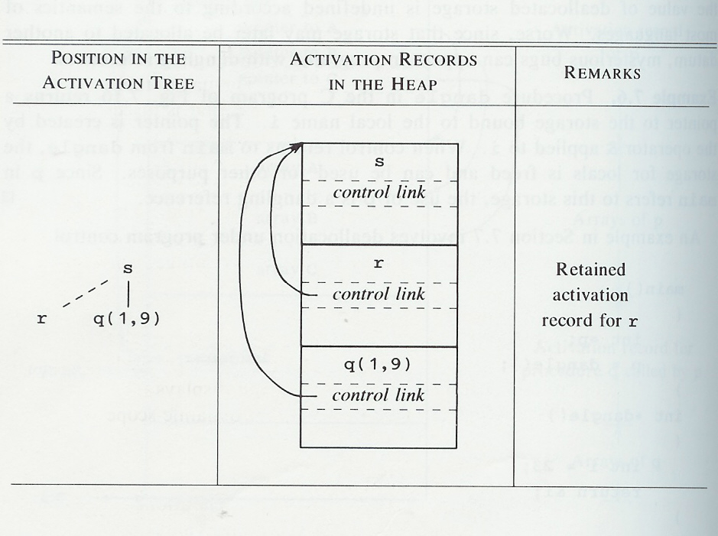
堆式分配

Slide 31
main()
{ /∗ begin of B₀ ∗/
int a = 0;
int b = 0;
{ /∗ begin of B₁ ∗/
int b = 1;
{/∗ begin of B₂ ∗/
int a = 2;
}/∗ end of B₂ ∗/
{/∗ begin of B₃ ∗/
int b = 3;
}/∗ end of B₃ ∗/
}/∗ end of B₁ ∗/
}/∗ end of B₀ ∗/
declaration | scope
int a = 0; | B₀ − B₂
int b = 0; | B₀ − B₁
int b = 1; | B₁− B₃
int a = 2; | B₂
int b = 3; | B₃

Slide 32
过程嵌套中访问非局部变量
program sort(input, output);
var a : array [0..10] of integer;
x : integer;
procedure readarray;
var i : integer;
begin … a … end; {readarray}
procedure exchange(i, j : integer);
begin
x := a[i];
a[i] := a[j];
a[j] := x
end; {exchange}
…

Slide 33
Nested Procedures Example (2)
…
procedure quicksort(m, n: integer);
var k, v : integer;
function partition(y, z: integer) : integer;
var i, j : integer;
begin … a …
… v …
… exchange(i, j); …
end; {partition}
begin … end; {quicksort};
begin … end. {sort}

Slide 34
嵌套深度
Sort 1
readarray 2
exchange 2
quicksort 2
partition 3
Nesting Depth of names a, v, and i in partition
a 1
v 2
i 3

Slide 35
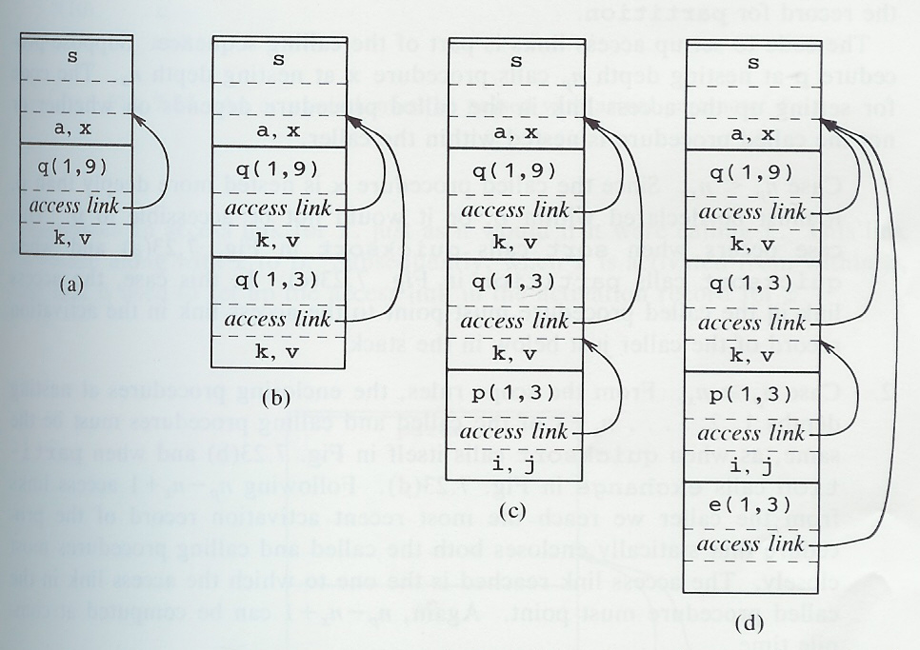
Access Links of Nested Procedures

Slide 36
Algorithm for Finding a Nonlocal
Suppose procedure p at nesting depth n_{p} refers to nonlocal a with nesting depth n_{a} ≤ n_{p}
If control is in p, activation record for p must be at top of stack
First follow n_{p}–n_{a} access links (computed at compile time)
  Easy if access links point to access links
  Brings us to activation record for procedure that a is local to
Storage for a at fixed offset to some position in record (fixed position could be access link)

Slide 37
Setting Up Access Links
Code to set up access links is part of calling sequence
Suppose procedure p with nesting depth n_{p} calls procedure x with nesting depth n_{x}
If n_{p}<n_{x}
  Procedure x must be declared within p
  Access link of x points to access link of p
If n_{p}≥n_{x}
  There must be some common enclosing procedure
  Following n_{p}–n_{x}+1 access from p brings us to activation record of common ancestor
  This is record to which access link for x must point

Slide 38
Procedure Parameters (1)
Lexical scope rules apply even when a nested procedure is passed as a parameter
The access link must be passed along with procedure parameter
Calling procedure must determine access link for passed procedure
When procedure parameter is activated, access link is used for activation record

Slide 39
Procedure Parameters (2)
program param(input, output);
procedure b(function h(n : integer) : integer);
begin writeln(h(2)) end; {b}
procedure c;
var m: integer;
function f(n : integer) : integer;
begin f := m + n end; {f}
begin m := 0; b(f); end; {c}
begin
c
end.

Slide 40
param
c
Access link
m
b
<f, >
Access link

Slide 41
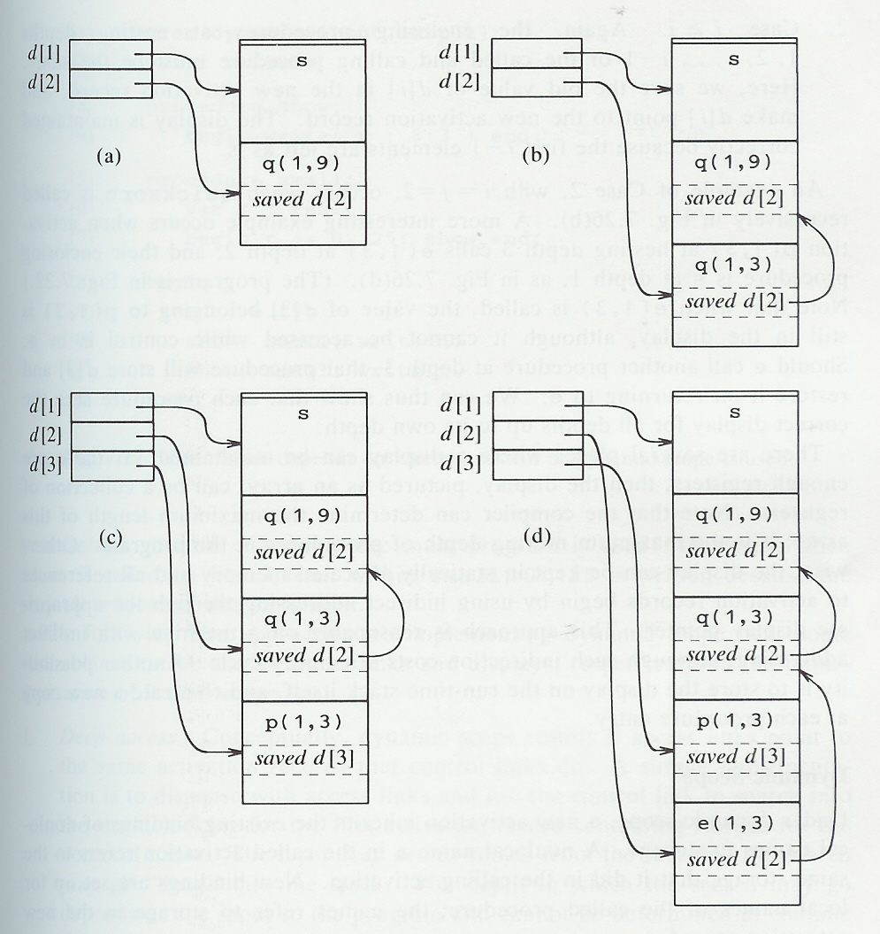
Display Example

Slide 42
Dynamic Scope
Under dynamic scope:
  A new activation inherits the existing bindings of nonlocal names to storage
  A nonlocal a in the called activation refers to the same storage as in the calling activation
The output of a program may depend on whether lexical or dynamic scope is used

Slide 43
7.5 Parameter Passing
When one procedure calls another, communication is done through:
  nonlocal names
  parameters of the called procedure
Several methods exist for associating actual and formal parameters
  call-by-value
  call-by-reference
  copy-restore
  call-by-name

Slide 44
L-values and R-values
Consider an assignment, e.g. a[i] := a[j]
The term l-value refers to the storage represented by an expression
The term r-value refers to the value contained in such storage
If an expression appears to the left of an assignment symbol, it represents an l-value
If an expression appears to the right of an assignment symbol, it represents an r-value

Slide 45
Call-by-Value
The simplest method of passing parameters
The actual parameters are evaluated and their r-values are passed to the called procedure
Used in C and sometimes Pascal
A formal parameter is treated like a local name, so storage in in the activation record
The caller evaluates the actual parameters and places the r-values in the storage for the formals

Slide 46
Using Call-by-Value (cont.)
Operations on formal parameters do not affect values in activation record of caller
A procedure called by value can affect its caller in two ways:
  Using nonlocals
  Through pointers that are explicitly passed as value

Slide 47
Call-by-Value Example (1)
program Call-by-Value(input, output);
var a, b : integer;
procedure swap(x, y: integer);
var temp : integer;
begin
temp := x;
x := y;
y := temp
end;
begin
a := 1; b := 2;
swap(a, b);
writeln('a = ', a); writeln('b =', b)
end.

Slide 48
Call-by-Value Example (2)
#include <stdio.h>
void swap(int *, int *);
int main(void) {
int a = 1, b = 2;
swap(&a, &b);
printf("a is now %d, b is now %d\n", a, b);
}
void swap(int *x, int *y) {
int temp;
temp = *x; *x = *y; *y = temp;
}

Slide 49
Call-by-Reference
Also known as call-by-address and call-by-location
The caller passes a pointer to the storage address of each parameter
If an actual parameter is a name or expression with an l-value, the l-value itself is passed
If the actual parameter is an expression without an l-value:
  The expression is evaluated in a new location
  The address of that location is passed

Slide 50
Call-by-Reference Example
program reference(input, output);
var a, b : integer;
procedure swap(var x, y: integer);
var temp : integer;
begin
temp := x;
x := y;
y := temp
end;
begin
a := 1; b := 2;
swap(a, b);
writeln('a = ', a); writeln('b =', b)
end.

Slide 51
Copy-Restore
Also known as copy-restore linkage, copy-in copy-out, or value-result
A hybrid between call-by-value and call-by-reference
The calling sequence:
  The actual parameters are evaluated before a call
  The r-values of the actuals are passed to the called procedure as in call-by-value
  In addition, the l-values of the actual parameters having l-values are determined before the call
The return sequence:
  When control returns, the current r-values of the actuals are copied back into the l-values of the actuals
  The l-values computed before the call are used (only actuals having l-values are copied)

Slide 52
Unusual Example
program copyout(input, output);
var a : integer;
procedure unsafe(var x : integer);
begin
x := 2;
a := 0
end;
begin
a : = 1;
unsafe(a);
writeln(a)
end.

Slide 53
Call-by-Name
Traditionally defined by the "copy-rule" of Algol
The procedure is treated as if it were a macro
  The body is substituted for the call in the caller
  Actual parameters are literally substituted for the formals
  Such a literal expansion is called macro-expansion of in-line expansion
  Local names of the called procedure are kept distinct from names of the calling procedure
  The actual parameters are surrounded by parentheses if necessary to preserve their integrity
Supposedly, there is no way to write a correct version of swap using call-by-name!

